Slide 1

Nike Product Sales Analysis and Insights
By: Tyler Ngo

Slide 2

PROJECT OVERVIEW & DATASET INTRODUCTION
Project Objective: Analyze Nike product sales data to uncover trends, patterns, and actionable insights for management decision-making.
Key Focus Areas:
Sales performance across product types and regions.
Trends in pricing, units sold, and revenue generation.
Identifying opportunities for optimization in sales strategy.
Dataset Overview:
Contains 2020-2021 data on product types, geographic regions, invoice dates, sales methods, prices, total sales, and units sold from the U.S.
Cleaned and prepared for accurate analysis and visualization.
Tools and Techniques Used: Power BI, Python, and Excel.

Slide 3

PRODUCT REQUIREMENTS DOCUMENT OVERVIEW
Objective: Provide insights to improve Nike’s product performance and decision-making.
Goals:
Identify top/underperforming products and regions.
Optimize pricing, inventory, and distribution strategies.
Visualize key sales metrics and trends.
Scope: Analyze sales data (product types, regions, pricing, revenue).
Deliverables: Cleaned dataset, interactive dashboard, actionable recommendations.
Full PRD: https://docs.google.com/document/d/1BtaMr2_LB_tF5naW6FuzrEw4Tc5vfNKNhcZ3WT95WWo/edit?usp=sharing

Slide 4


Slide 5
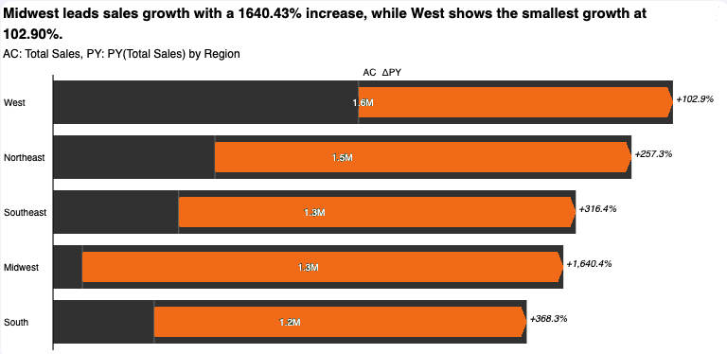
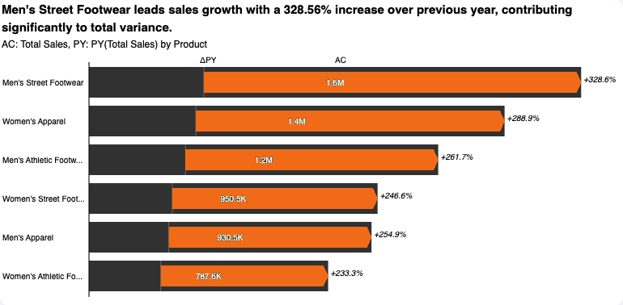
SALES ANALYSIS
Regional Growth:
The Midwest showed the highest sales growth (+1,640.43%) despite lower overall sales compared to the West.
The West had the smallest growth (+102.9%) but maintained the highest sales volume (1.6M).
Product Growth:
Men’s Street Footwear had the largest sales growth (+328.56%) and the highest sales volume (1.6M).
Women’s Athletic Footwear and Men’s Apparel showed the lowest growth rates but still contributed significantly to total sales.
Key Takeaway:
Growth is concentrated in emerging regions like the Midwest and product categories like Men’s Street Footwear, suggesting opportunities for targeted investments.

Slide 6
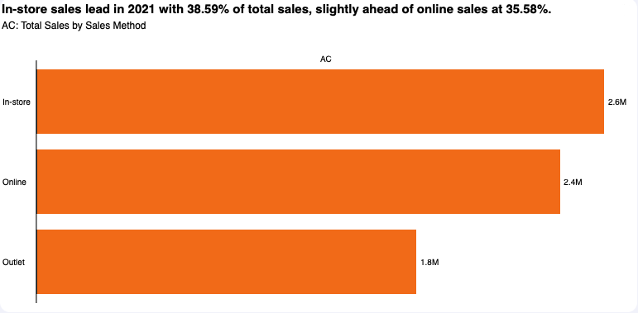
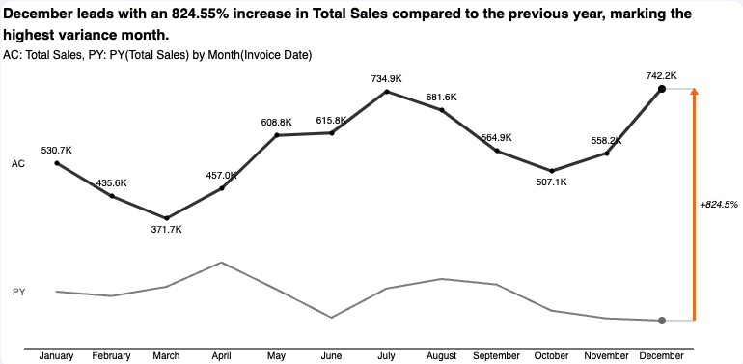
SALES ANALYSIS
In-Store Leadership:
In-store sales dominate with 38.59%, highlighting its importance in driving revenue.
E-commerce Growth Opportunity:
Online channels rank second, showcasing growing consumer adoption of digital shopping.
Outlet Challenges:
Outlet sales at 25.83% suggest weaker performance compared to other channels, requiring targeted improvements.
Seasonal Trends:
December recorded the highest sales growth (+824.55%) compared to the previous year, marking it as the peak sales month.
Sales dipped significantly in February and March, highlighting a seasonal low point.
Monthly Performance:
Strong recovery was observed starting in May, with steady growth leading to a peak in July (734.9K).
Sales declined in the fall but rebounded sharply in December.

Slide 7
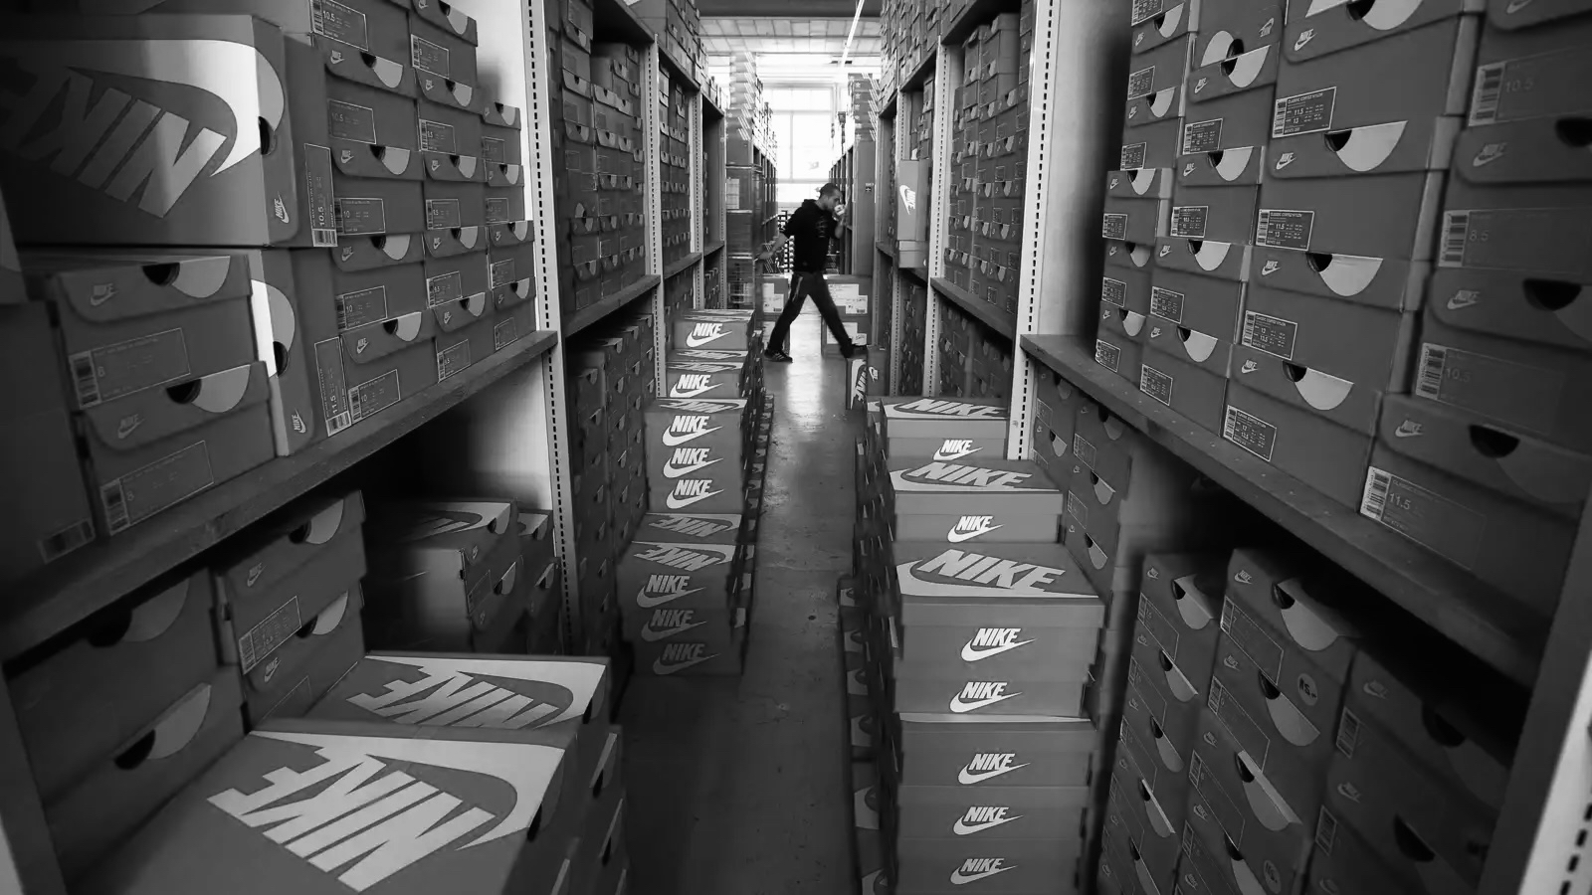
BUSINESS IMPLICATIONS
Revenue Optimization: Focus on top-performing products and regions to drive sales growth.
Cost Efficiency: Address underperforming products to reduce inventory waste and streamline operations.
Market Strategy Refinement: Use geographic insights to target high-potential regions and sales channels.
Customer Behavior Insights: Tailor marketing and product offerings based on purchasing trends.
Pricing Strategy: Adjust pricing to maximize revenue and competitiveness in key markets.
Data-Driven Decision-Making: Empower management with actionable insights to enhance product and sales strategies.

Slide 8
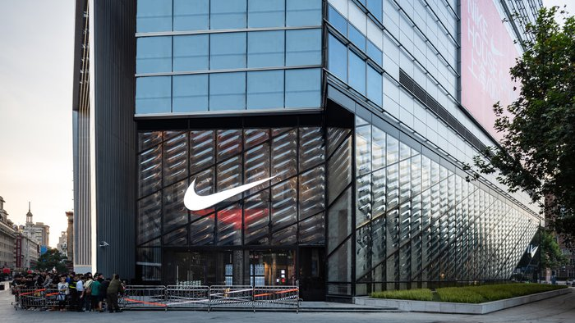
RECOMMENDATIONS FOR MANAGEMENT
Targeted Marketing Campaigns: Focus on promoting women’s street footwear, men’s apparel, and women’s athletic footwear through regional and digital marketing initiatives.
Boost Online Presence: Optimize product listings and advertising strategies for Amazon and Walmart to increase online sales.
Regional Strategy Refinement: Allocate additional resources to Midwest states, such as Nebraska and Minnesota, to improve sales.
Leverage High-Performing States: Expand product offerings and marketing efforts in New York and California to maintain momentum.
Strengthen Retail Partnerships: Invest in exclusive collaborations and promotions with successful retailers like West Gear and Foot Locker.
Data-Driven Adjustments: Continuously analyze sales data to identify new opportunities and monitor the impact of implemented strategies.

Slide 9
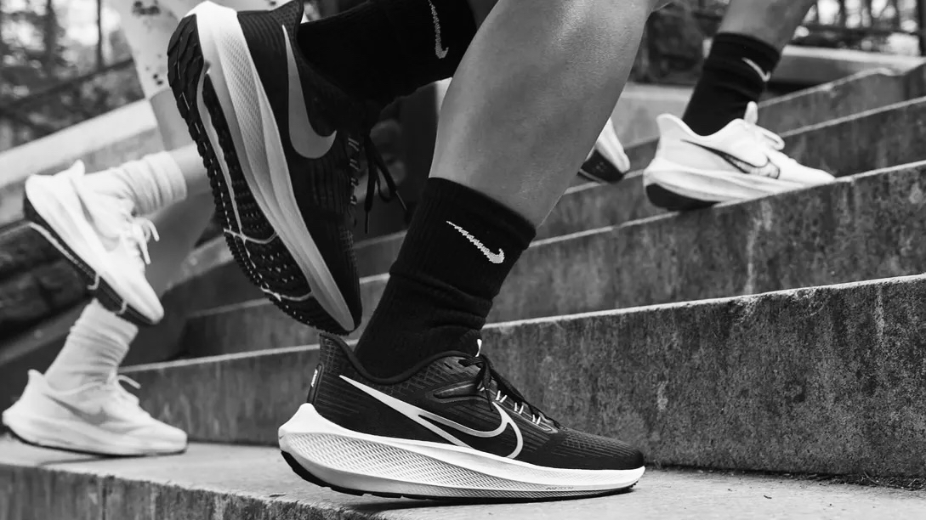
FUTURE STEPS
Boost Low-Performing Products: Improve marketing for women’s street footwear, men’s apparel, and women’s athletic footwear.
Strengthen Online Sales: Enhance product visibility on Amazon and Walmart.
Expand Midwest Market: Focus on marketing and partnerships in underperforming states.
Replicate Success: Apply strategies from high-performing regions like New York and California.
Leverage Retailer Success: Deepen collaborations with West Gear and Foot Locker.
Continuous Analysis: Use updated data to refine strategies.

Slide 10


